Slide 1
HS Corpus Linguistics / Korpuslinguistik 1. Introduction & Techniques of corpus linguistics
Prof. Dr. Stephanie Evert
Chair of Computational Corpus Linguistics
www.linguistik.uni-erlangen.de

Slide 2
Language
🇬🇧
🇩🇪
contributions allowed (except MA English Studies)

Slide 3
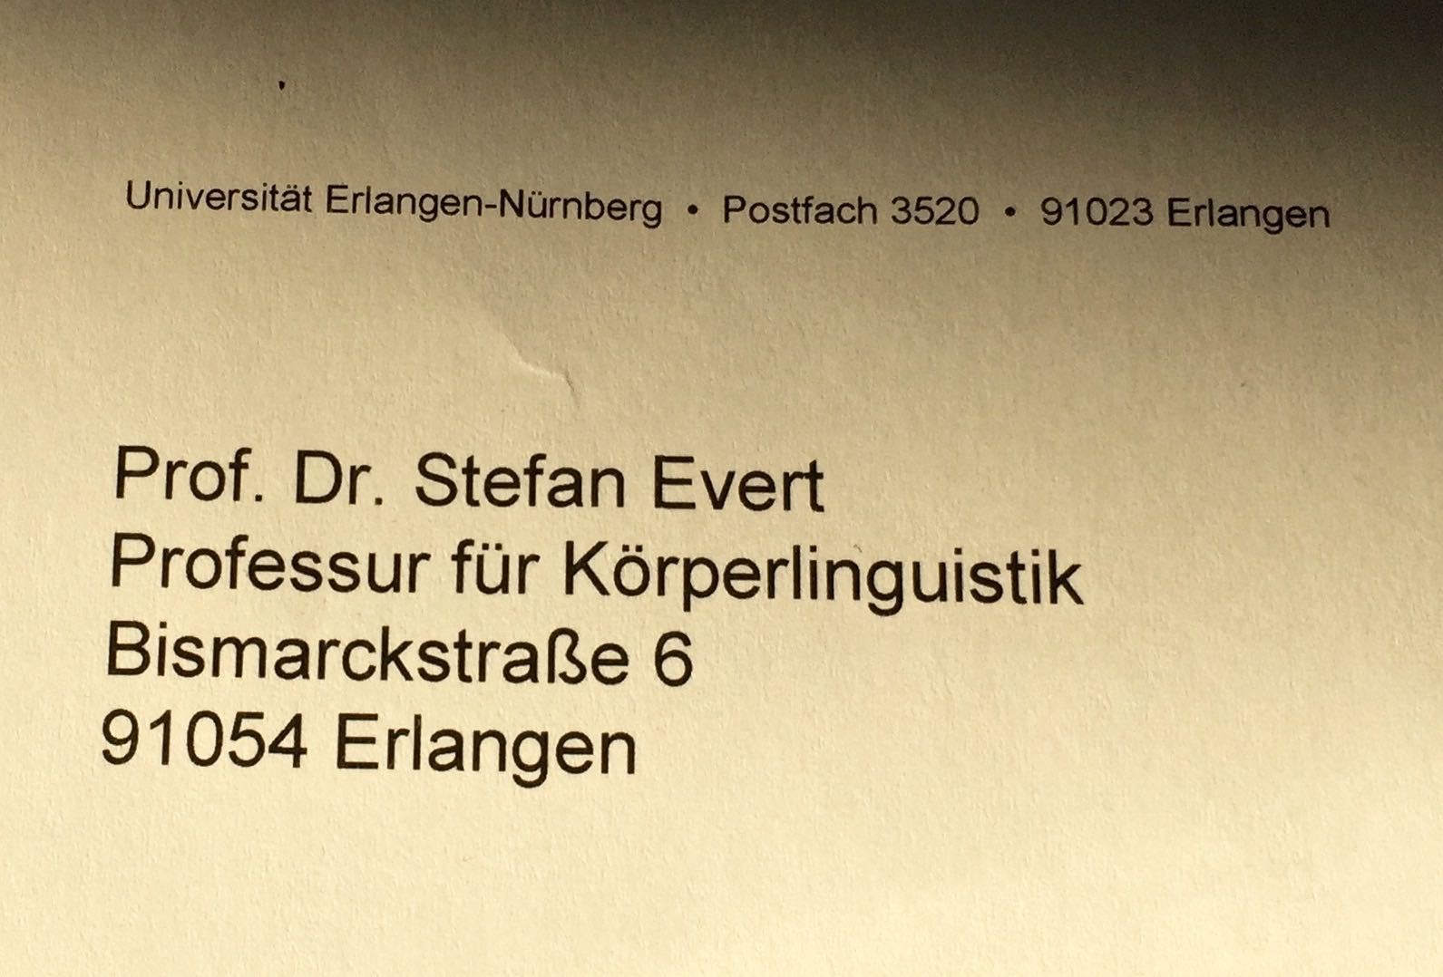
What is a corpus?

Slide 4
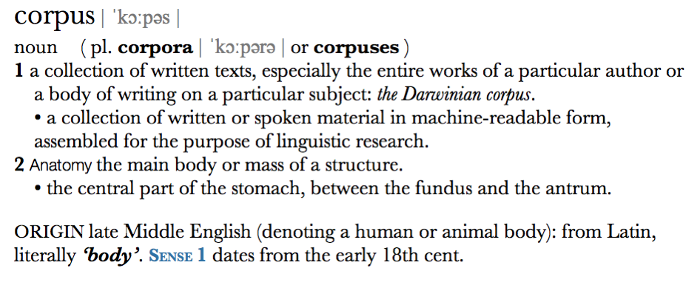
What is a corpus?
Corpus as electronic text collection (archive / database)
wide sense: common in computational linguistics & digital humanities
Corpus as representative sample of language
narrow sense: dominant in corpus linguistics (in narrow sense)

Slide 5
What is corpus linguistics?
Corpus linguistics as a methodology
(one form of) empirical evidence for linguistic research
corpus design & practical aspects
development of software tools
quantitative analysis techniques, often in terms of frequency comparison
Corpus linguistics as discipline
concordance, collocations, keywords
language in use, not language as system
language as a medium ➞ applied CL
typical research topics
Corpus-based research
verification of hypotheses and theoretical predictions
compilation of specialised corpora
exploration of specific constructions
statistical significance of differences, data analysis as discovery procedure
Corpus-driven research
“trust the text” (Sinclair 2004)
purely empirical, inductive, contextualised
socio-political discourses & rhetoric
sociolinguistic & functional aspects language variation computational lexicography language pedagogy (➞ CALL) …

Slide 6
Corpus linguistics vs. Theoretical linguistics
Corpus linguistics
long tradition in esp. British linguistics since 1950s (Quirk, Firth, Sinclair, Leech, …)
based on corpus data, i.e. authentic language use
empiricist / inductive
patterns & preferences
frequency
“ordinary” language in use
empirical validation of theory, induction of new hypotheses
goals: language use, language as medium
Generative linguistics
mainstream of theoretical linguistics since early 1960s (Chomsky 1957)
based on introspection and grammaticality judgements
rationalist / deductive
rules
yes / no (grammaticality)
language system, border cases
theory developed on basis of individual (invented) examples
goal: cognitive account of language faculty
Notes:
• extreme Darstellung zweier gegensätzlicher Positionen
• entspricht der Situation ca. 1960–1990
• moderen Arbeiten kombinieren oft beide Ansätze: Korpusdaten werden mit Introspektion interpretiert; Theoriebildung; empirische Überprüfung

Slide 7
Requirements
Module Corpus Linguistics (MA English Studies, MA Linguistik)
HS Corpus Linguistics (7 credits) | Fri 10–12, CIP pool (0.320, Bismarckstr. 12)
Ü The corpus linguist's essential toolbox (3 credits) | Fri 12–14, CIP pool | lecturer: Dr. Besim Kabashi
Module Korpuslinguistik (BA Linguistische Informatik)
HS Korpuslinguistik (5 credits) | Fri 10–12, CIP pool
Ü Statistik für Korpuslinguisten (5 credits) | Tue 14–16, CIP pool | lecturer: Philipp Heinrich, M.Sc.
Presentation
discussion of research paper(s), ideally combined with small corpus study / replication of findings
with presentation slides, duration: 15–20 minutes + 10 min discussion
Term paper (only MA)
ca. 15 pages, usually based on the presentation (and feedback from discussion)
grade: term paper (HS, 70%) + exercises (Ü, 30%)
Notes:
HS = advanced seminar
Ü = practical course

Slide 8
Semester overview
29.04. Introduction + Techniques of CL
get-to-know, a first look at a corpus
06.05. Fundamentals
list of presentation topics
13.05. Statistical analysis: frequency data
20.05. Corpus compilation & annotation
discussion on coprus design
assignment of presentation topics
27.05. Hands-on: CADS & MMDA 1
03.06. Hands-on: CADS & MMDA 2
10.06. Hands-on: CADS & MMDA 3
17.06. Corpus queries & indexing
24.06. Statistical analysis: non-randomness
01.07. Student presentations 1–3
08.07. Student presentations 4–6
15.07. Student presentations 7–9
22.07. Student presentations 10–12
29.07. Student presentations 13–15
summary & final discussion
instructions and Q&A for term papers

Slide 9
Special feature
Hands-on block of three sessions with practical corpus study
Ties into cutting-edge research on digital hermeneutics
theoretical framework and hermeneutic methodology for corpus-assisted discourse analysis (CADS)
innovative software support for qualitative-quantitative studies: MMDA toolkit
Preliminary schedule
Introduction to CADS
Group work: corpus study on hermeneutic methodology
Group work: corpus study using MMDA toolkit vs. traditional corpus software
Co-teachers for this block (PhD researchers @ CCL)
Nathan Dykes, M.A. (framework & methodology for CADS)
Philipp Heinrich, M.Sc. (MMDA development)

Slide 10

Introductions
Who are you? And how do I pronounce your name?
Which degree programme are you enrolled in?
What background do you have in linguistics, corpus research, computer science, NLP?
What do you know about corpus linguistics?
Have you ever worked with corpora?
How could your own research benefit from corpora?
What do you expect from this seminar?
Any other questions?
All materials in the StudOn course HS Corpus Linguistics / Korpuslinguistik – SS 2022

Slide 11

Techniques of corpus linguistics: A hands-on example
Goal: Understand this [➞] guy's rhetoric, terminology, phraseology and topics just in case he comes back …
How would you approach this task?
We need a large collection of texts written by Trump, e.g. the Trump Twitter Archive [www.thetrumparchive.com]
Step 1: Compile a linguistically annotated corpus (TTA)
Step 2: Upload to indexing & search engine
Step 3: Analyse with corpus-linguistic techniques

Slide 12
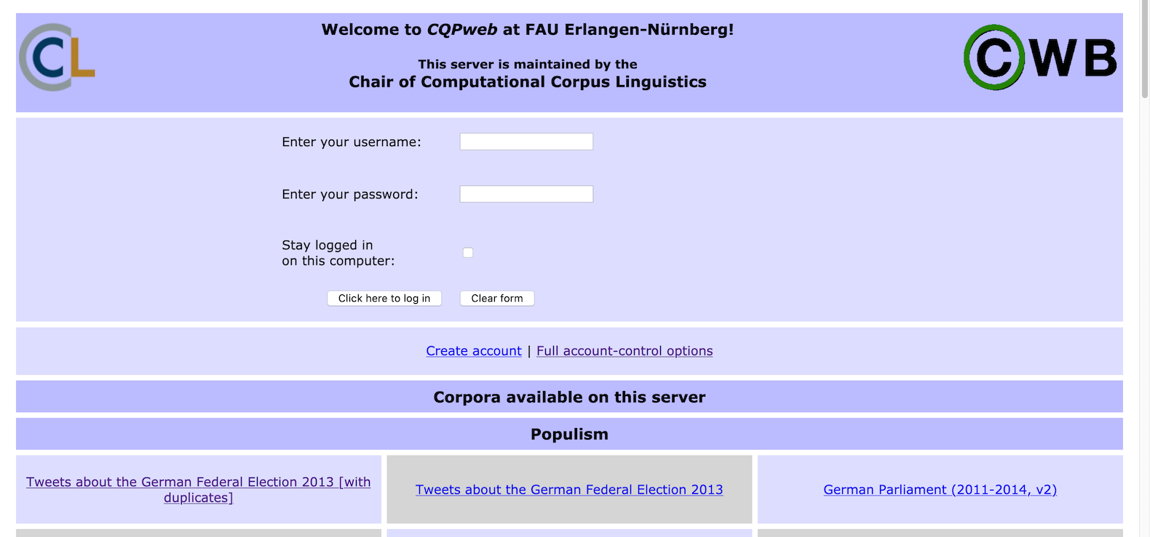
Techniques of corpus linguistics: A hands-on example
Hands-on experience with CQPweb and the Trump Twitter Archive
go to https://corpora.linguistik.uni-erlangen.de/cqpweb/ and login as student1 … student15
select corpus Trump Twitter Archive from “Political Tweets” section

Slide 13
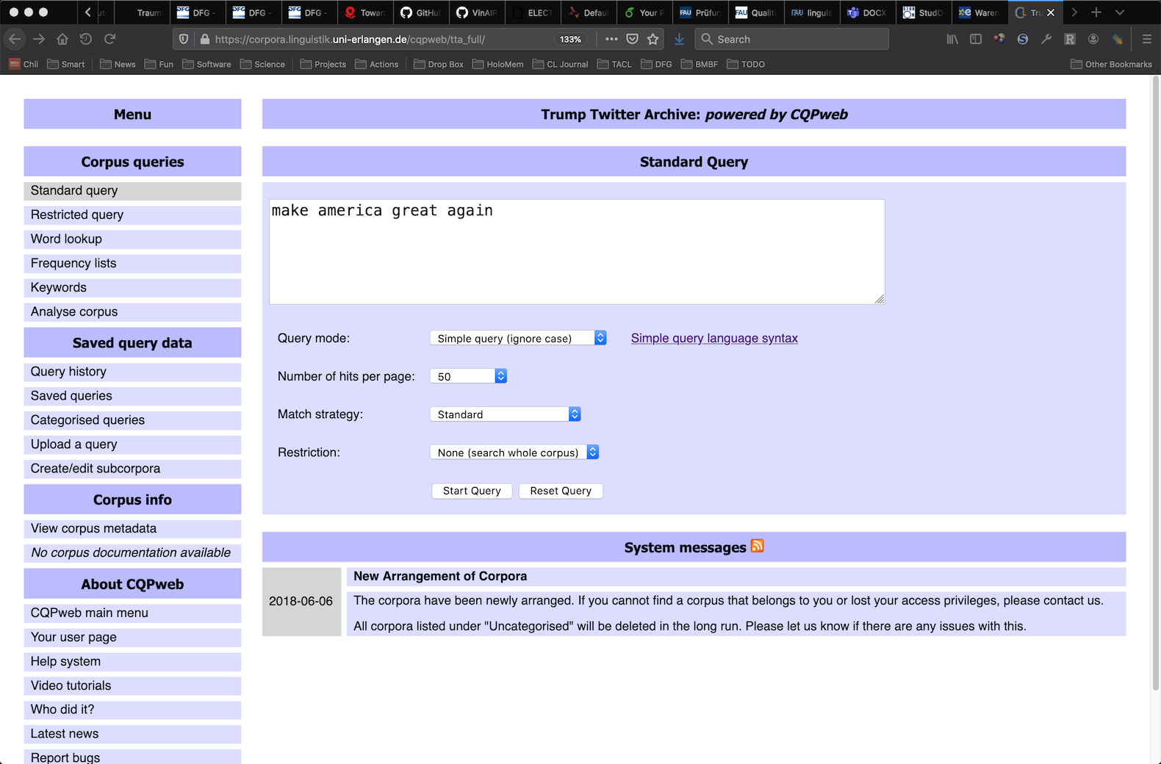
Simple search

Slide 14
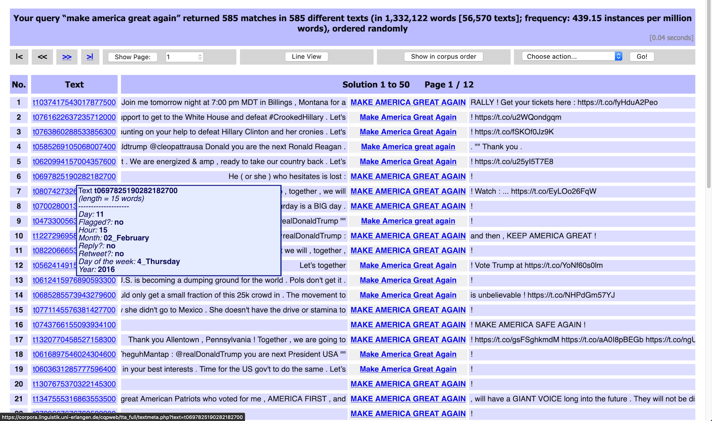
Concordance (kwic = key word in context)
frequency information
random ordering
click for context
click / hover for metadata

Slide 15
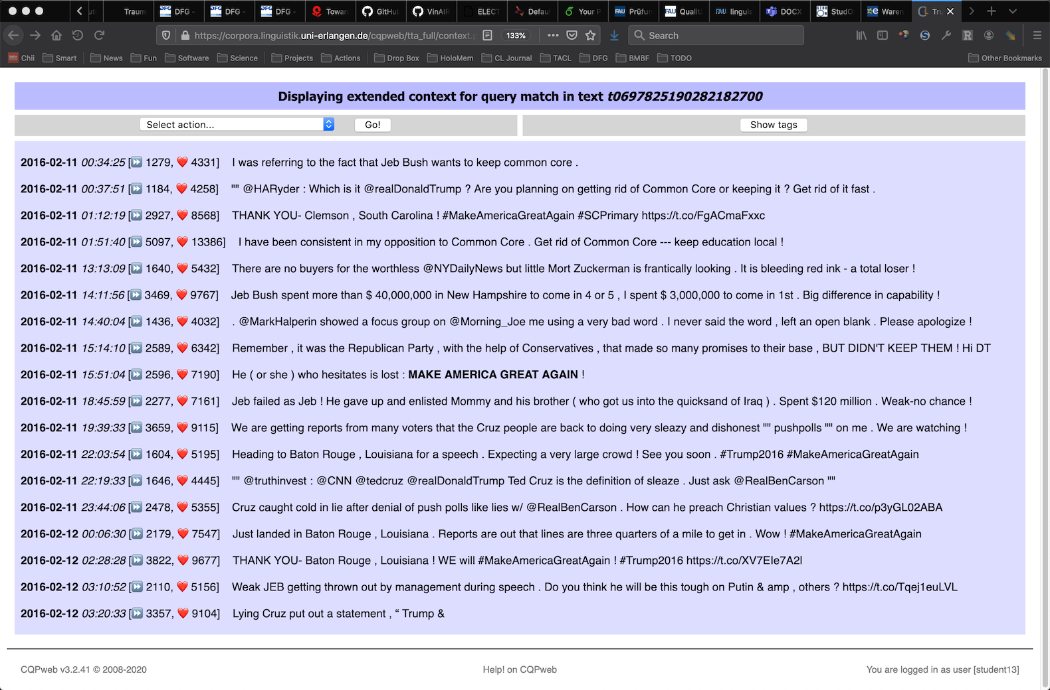
Extended context display with formatting
this is the match

Slide 16
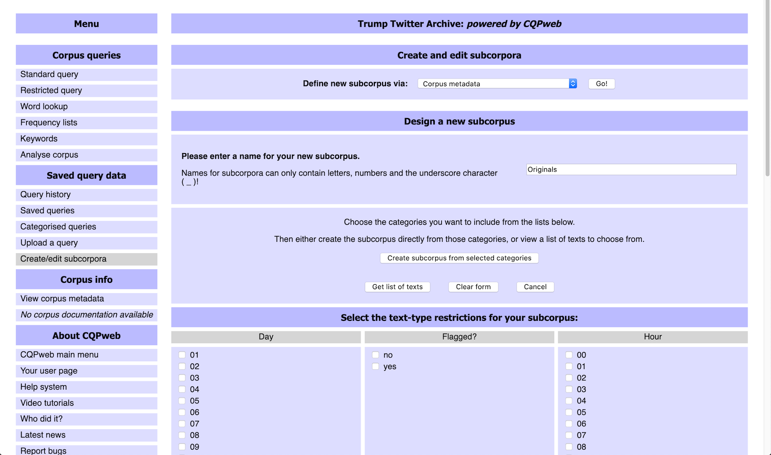
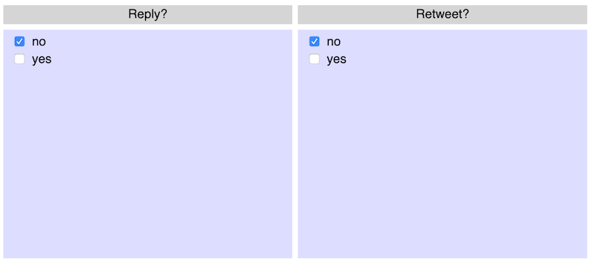
Create subcorpus for targeted search
only original tweets

Slide 17
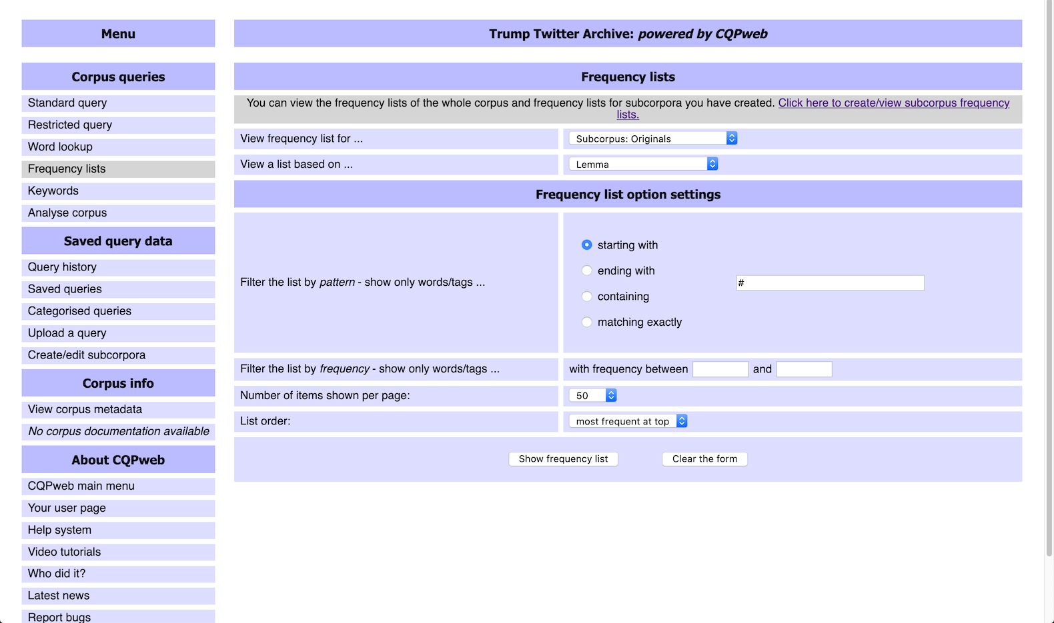
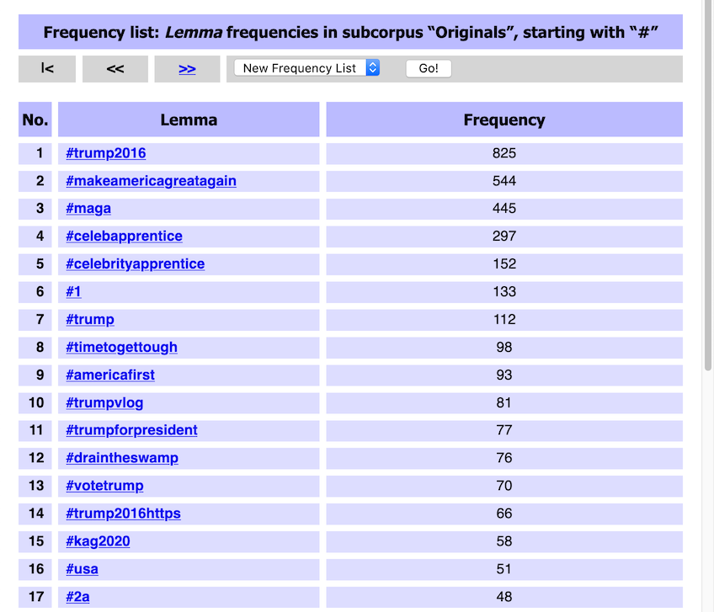
Frequency list for hashtags
must compile frequency list for subcorpus first
hashtags

Slide 18
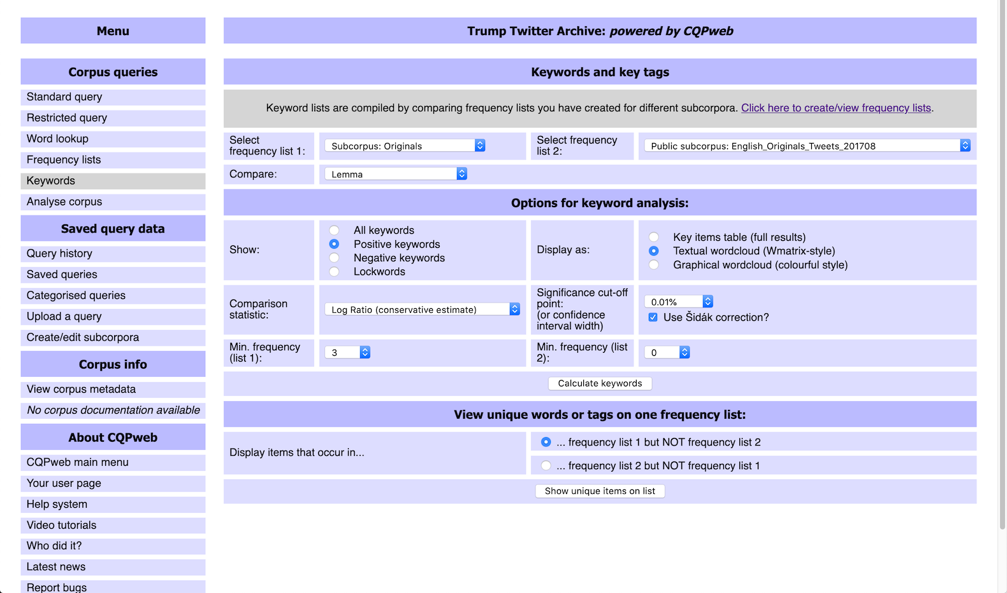
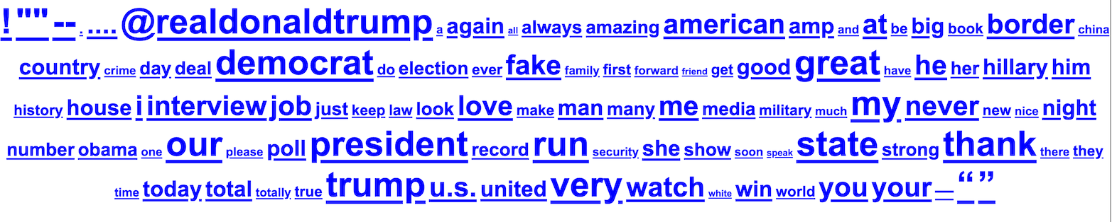
Keywords vs. reference corpus
suitable reference corpus
recommended settings
click for concordance

Slide 19
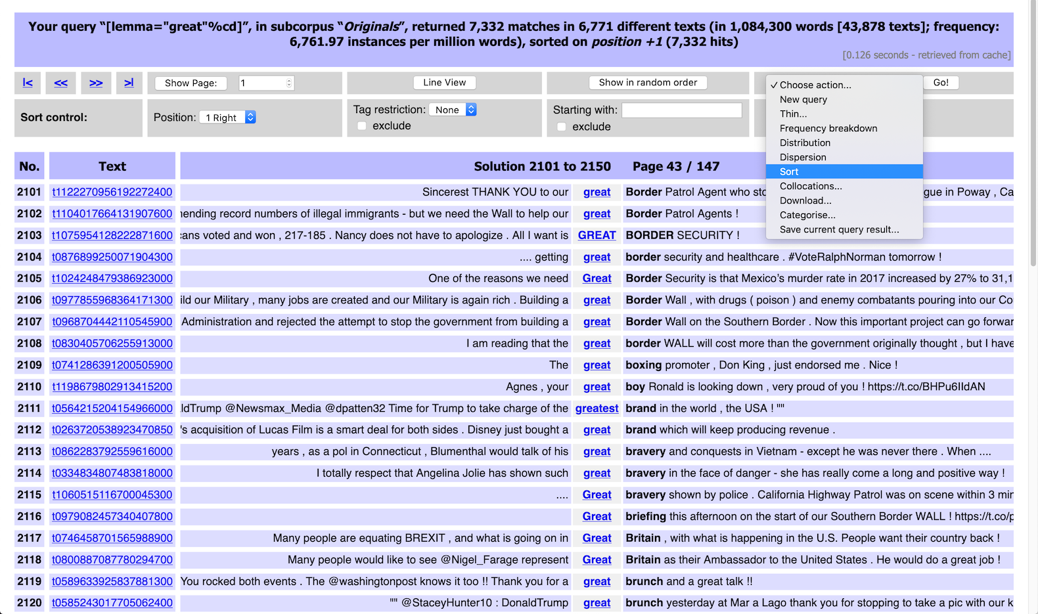
Sorted concordance: great
action menu

Slide 20
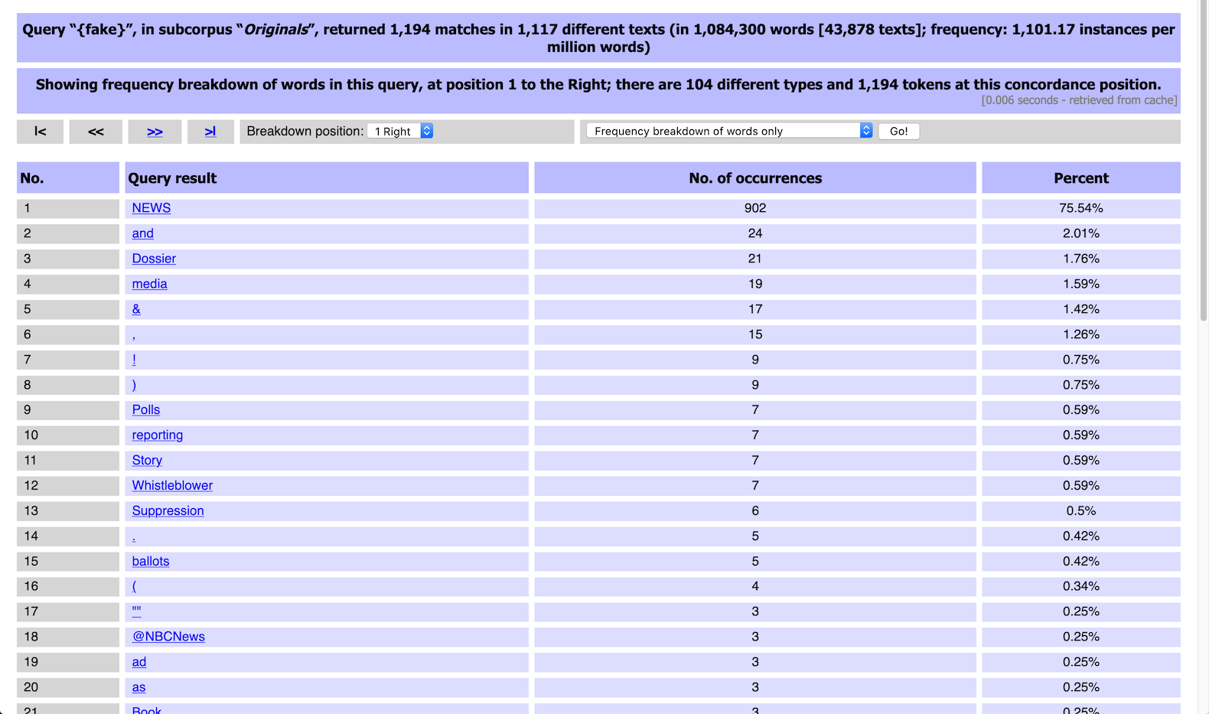
Frequency breakdown: fake
full process history

Slide 21
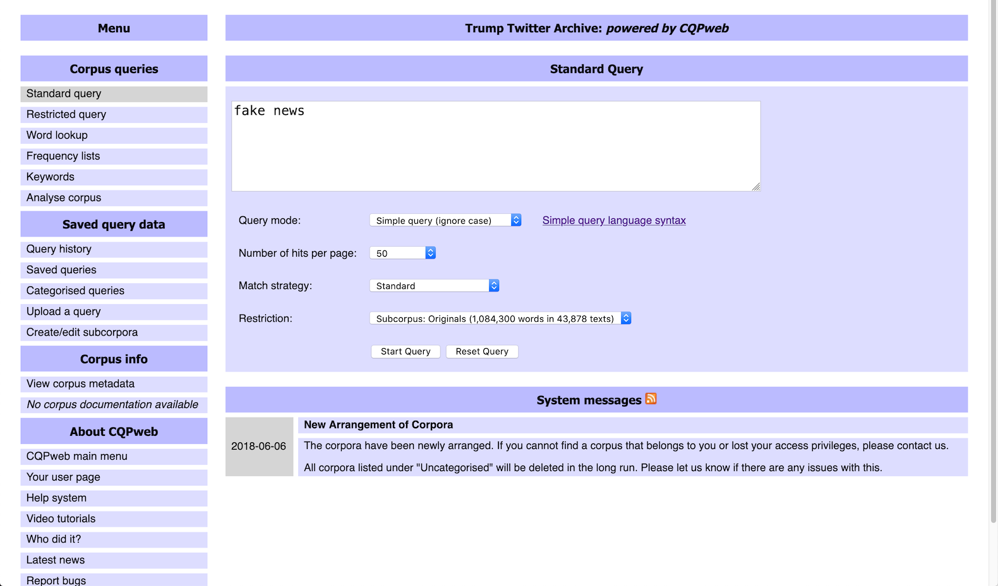
Time for a closer look: fake news

Slide 22
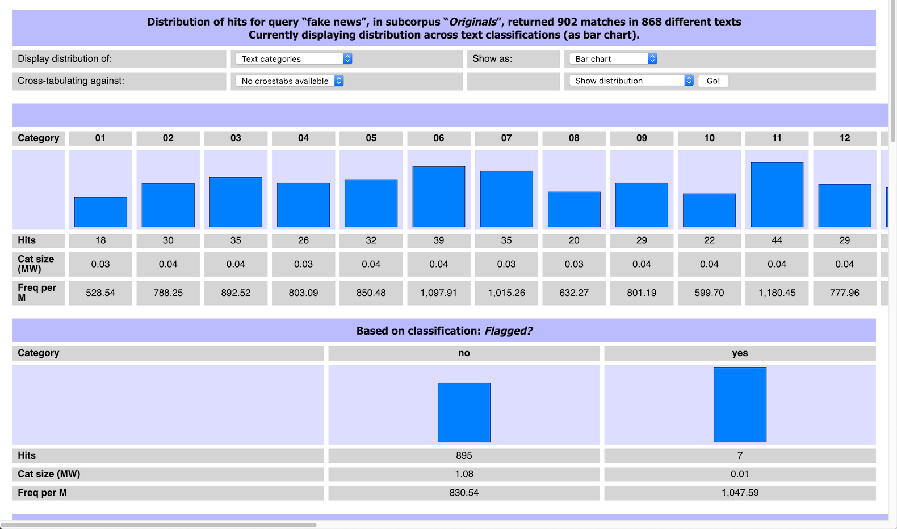
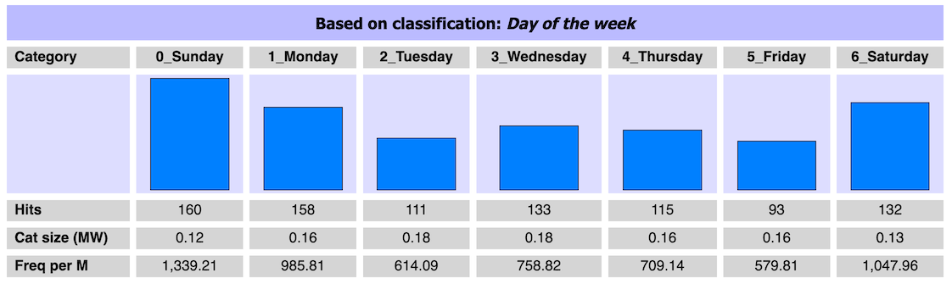
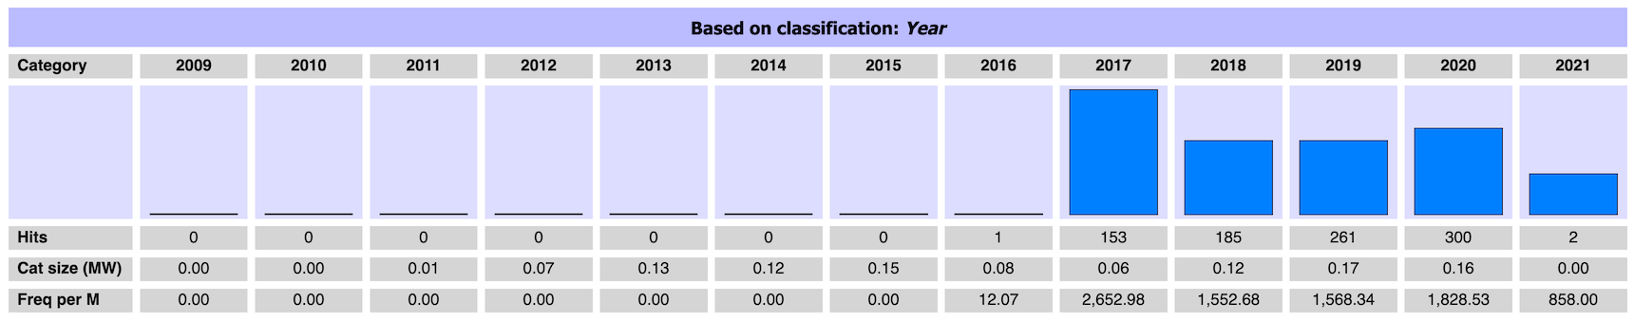
Distribution across metadata categories

Slide 23
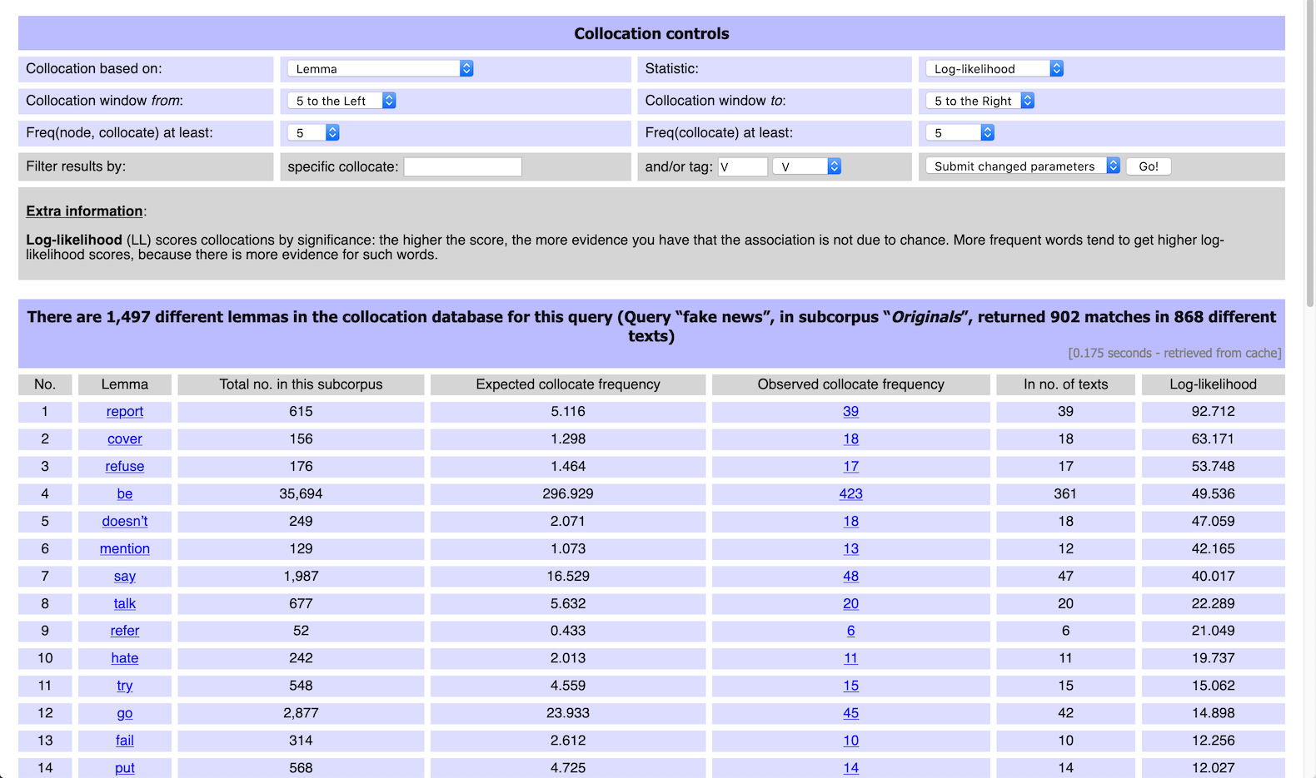
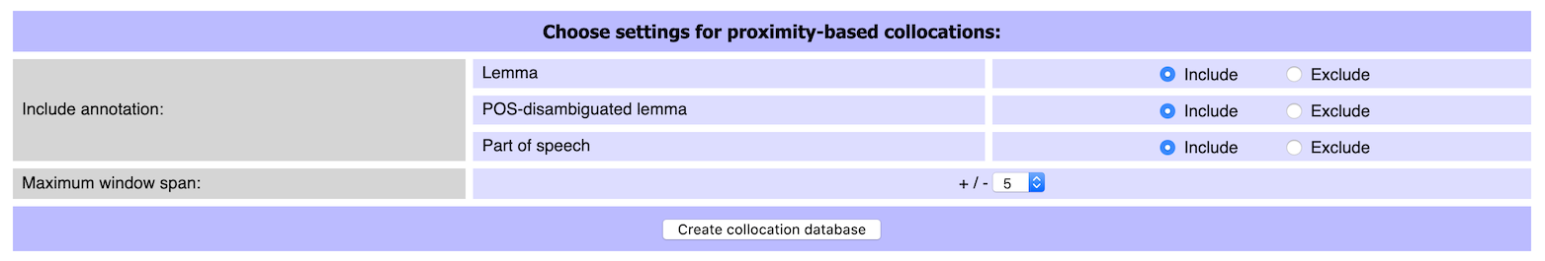
Collocation analysis
key parameters
click for examples

